Slide 1
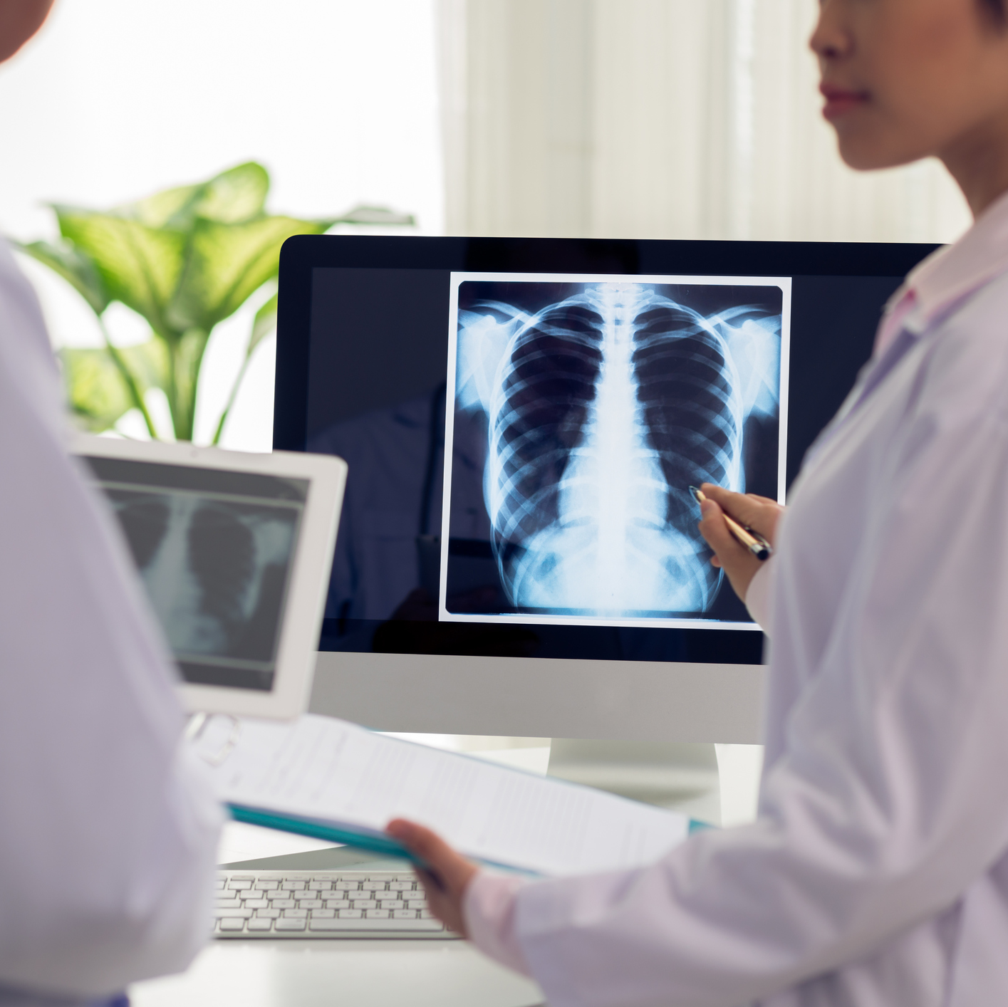
Developing neural networks for diagnosing pneumonia in patients
Michael Flores
Flatiron School

Slide 2
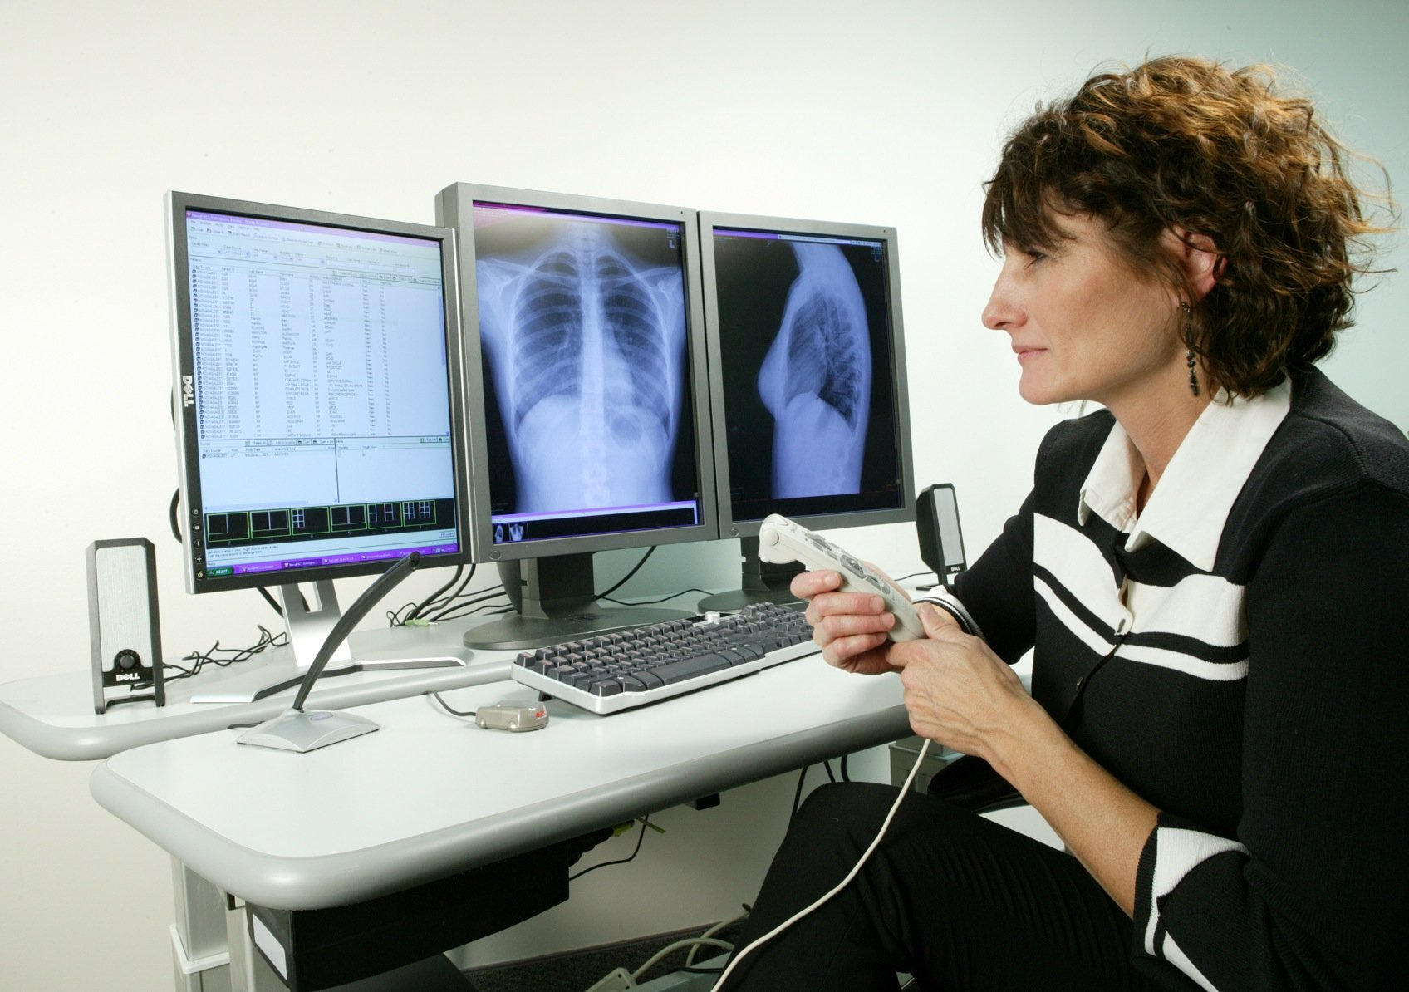
Introduction
Neural Networks are a powerful new technology used for its effectiveness at detecting and learning complex patterns.
Medical professionals are especially interested in image classification technologies for evaluating and diagnosing patients.
The purpose of the project was to develop a neural network capable of diagnosing whether a patient had pneumonia or not.

Slide 3
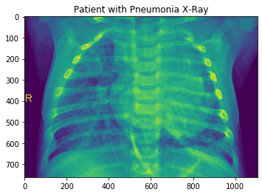
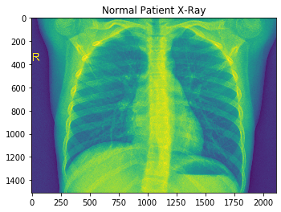
Data setup
The dataset used consisted of nearly 6,000 chest x-rays of pediatric patients.
The images provided were already pre-classified as whether the patient had pneumonia or not.
Each of our models will iterate over the same dataset and “learn” how to improve its effectiveness.

Slide 4
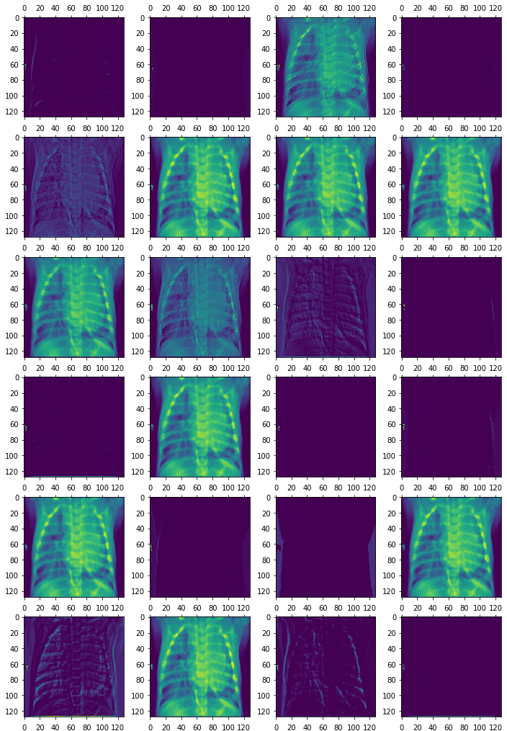
Network Models Used
Convolutional neural networks were the main network architectures we examined.
We took an iterative approach towards finetuning and improving the models.
We also used pre-trained models specifically VGG19 and Xception.

Slide 5
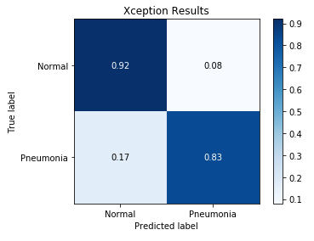
Model Results
Model Design | Overall Accuracy | Normal Recall | Pneumonia Recall
Convolutional Neural Network | 79% | 98% | 48%
CNN w/ Padding | 86% | 95% | 71%
CNN w/ Padding and Dropout | 83% | 96% | 62%
VGG19 | 86% | 98% | 66%
Xception | 88% | 92% | 83%
The metrics used for measuring a model’s performance was its overall accuracy and accuracy in diagnosing patients with pneumonia.
Some models performed exceptionally well at diagnosing healthy patients.
Out of all the models tested, Xception performed the best on both metrics.

Slide 6
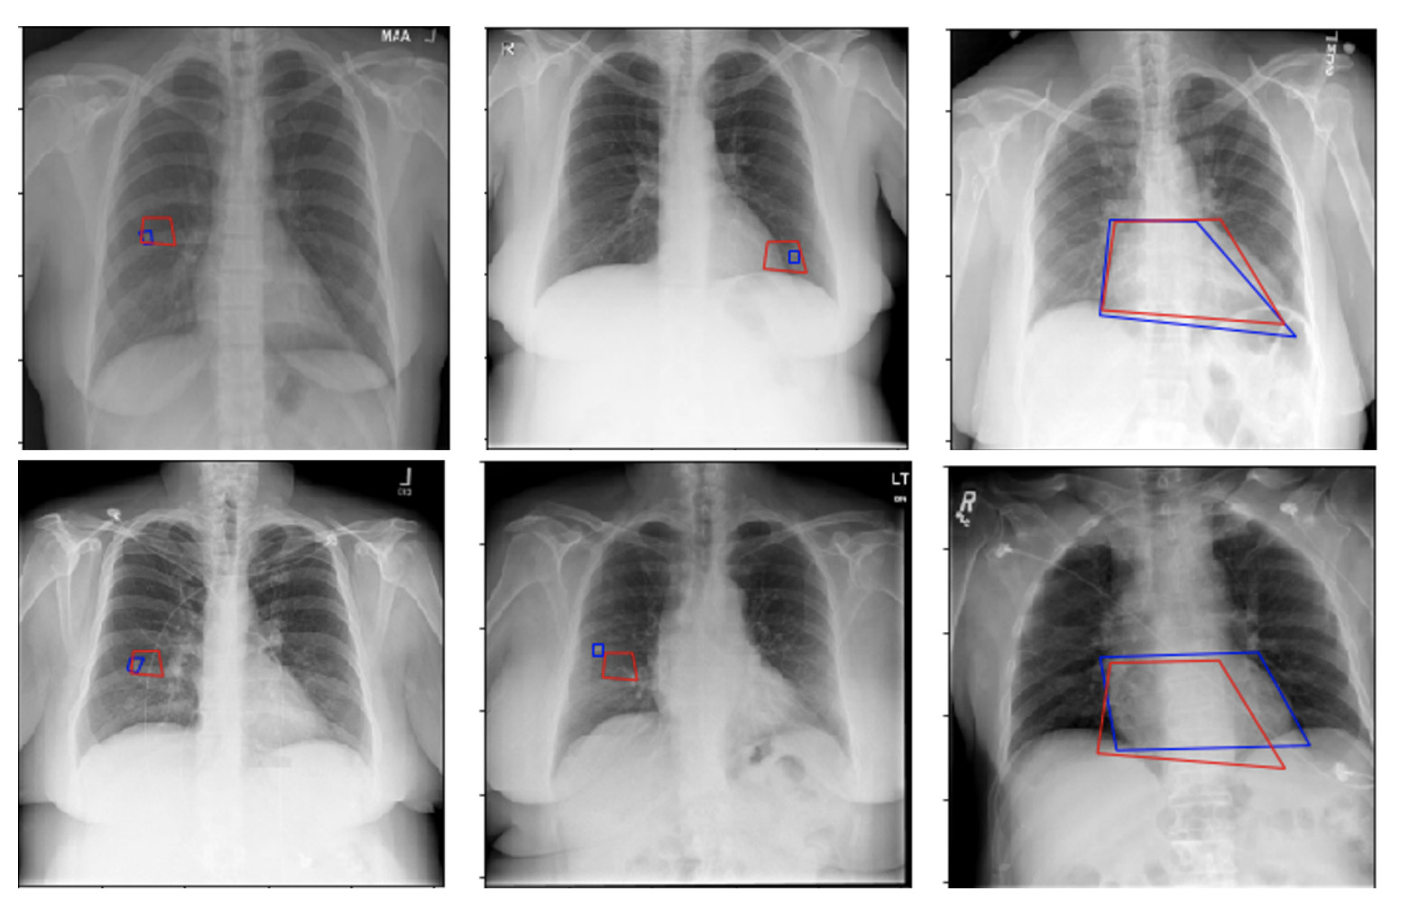
Conclusions and future work
Xception was the best model we found for diagnosing patients accurately.
We’d like to improve this model further with access to more x-ray result datasets.
Implementing this technology further to diagnosing other major illnesses such as cancer and COVID-19.
Implementing this technology with other medical imaging such as CT and MRI scans.

Slide 7
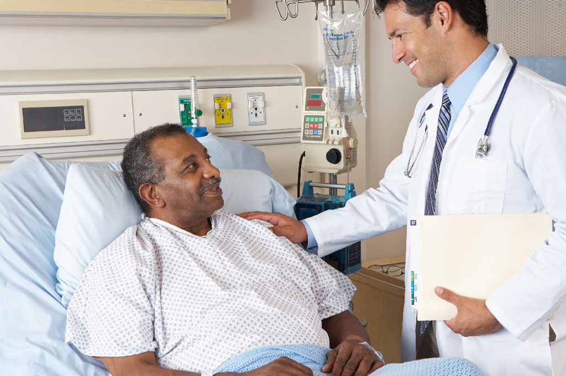
Thank you!

